Slide 1
In the north
In the East
In the South
In the West
High Crimes in India

Slide 2
Bihar
Odisha
West Indian States

Slide 3
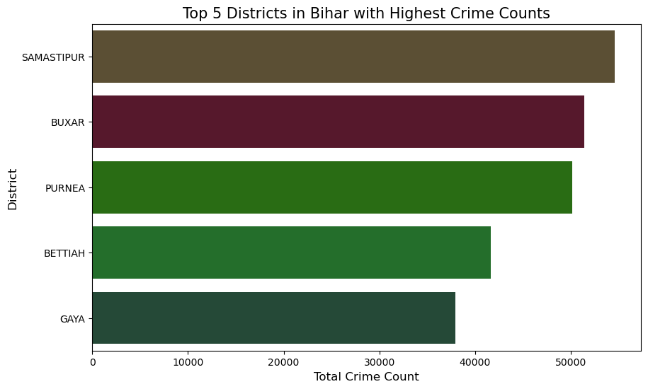
Districts in Bihar

Slide 4
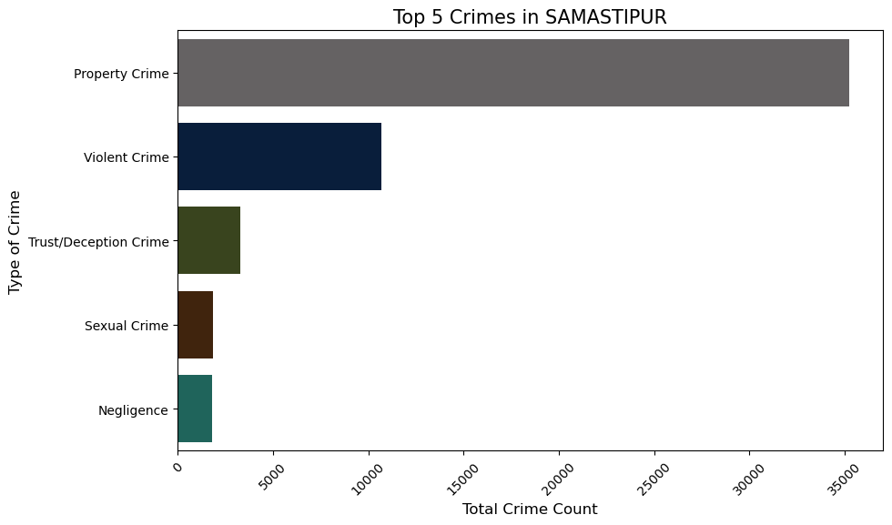
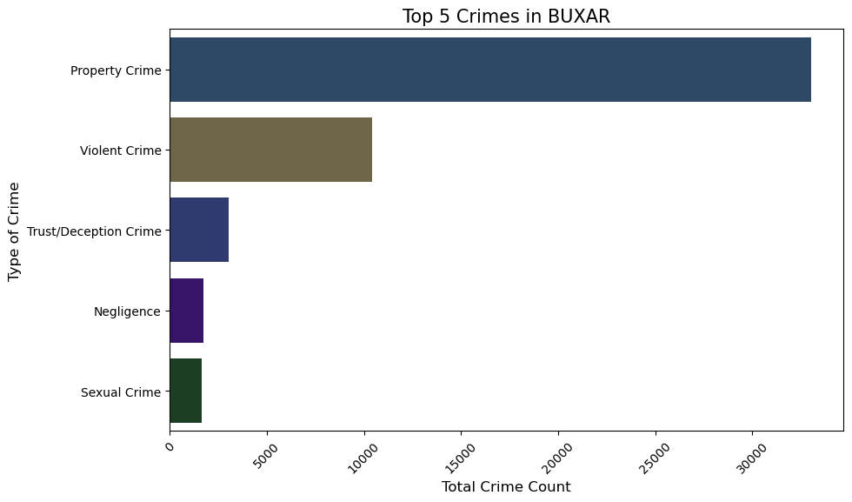
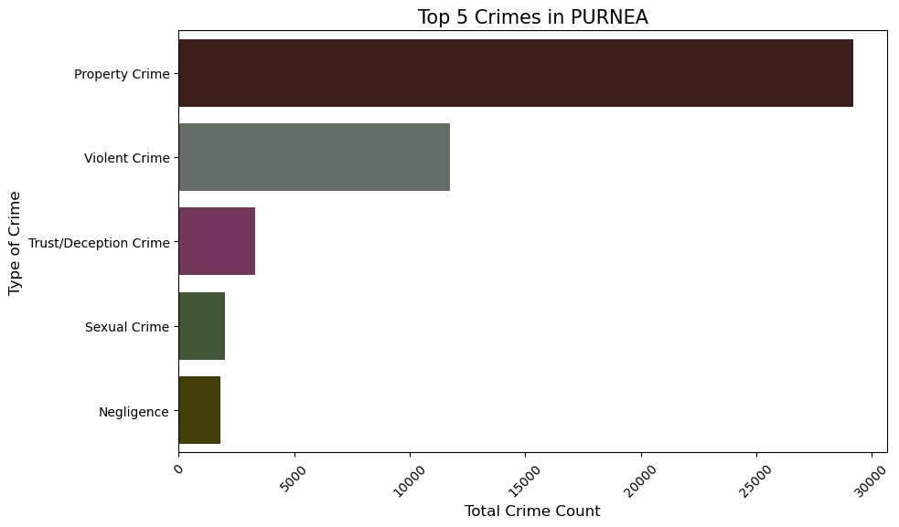
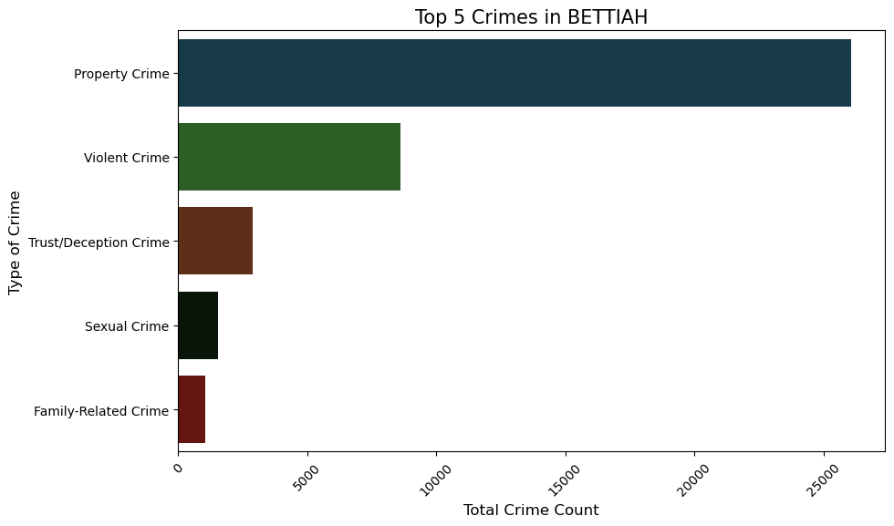
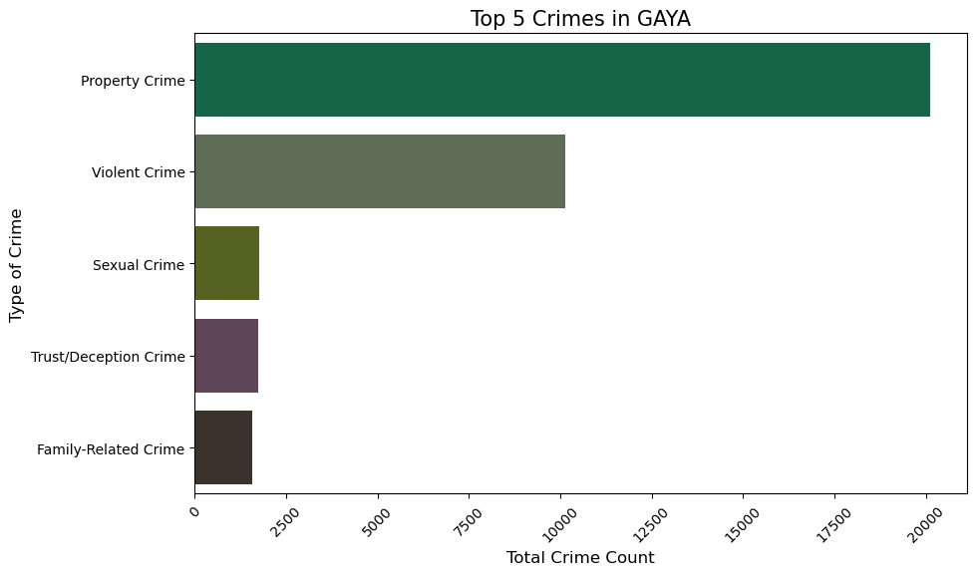
Districts in Bihar

Slide 5
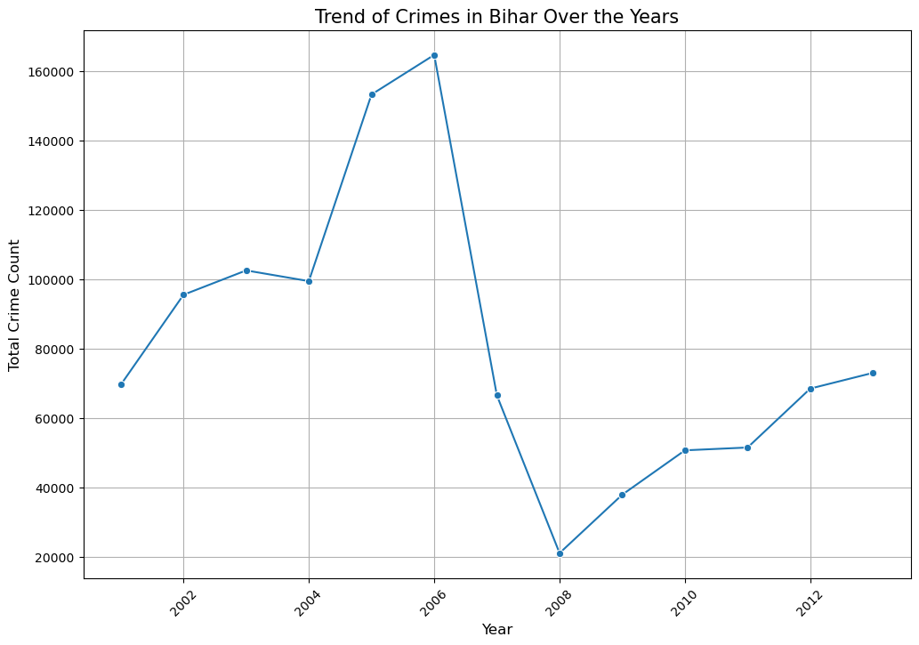
Analysis of Data – Bihar

Slide 6
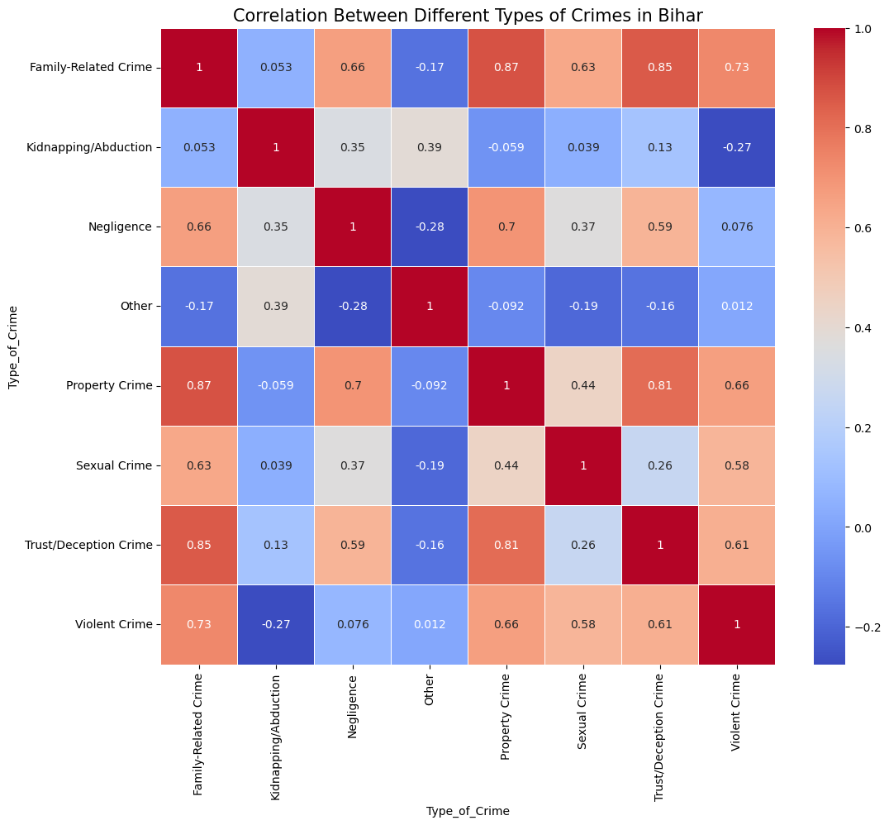
Analysis of Data – Bihar

Slide 7
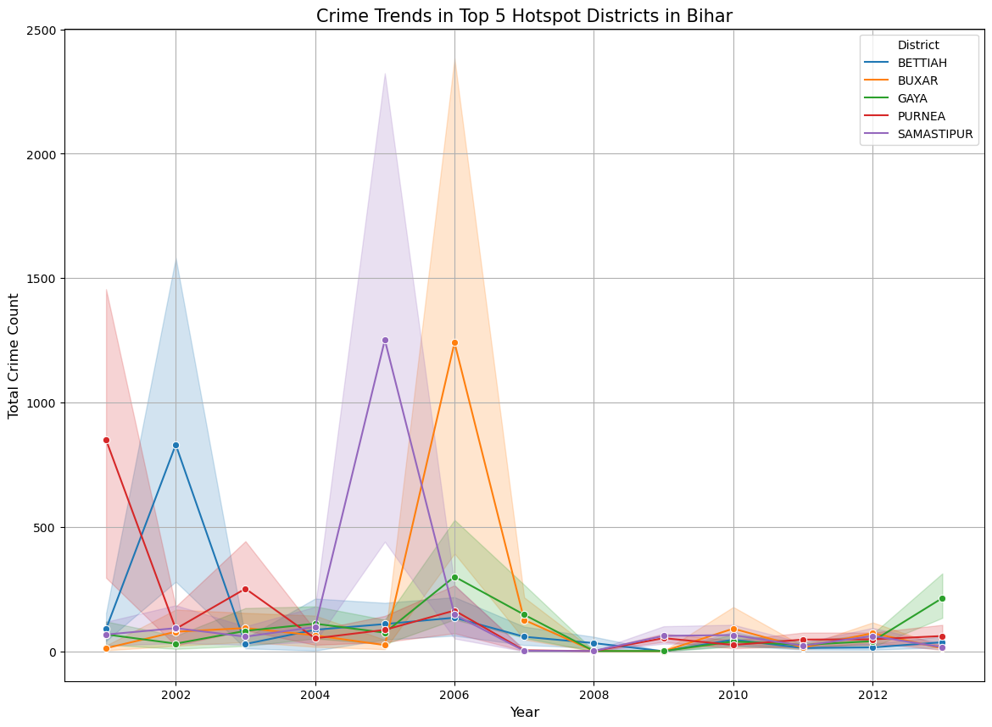
Analysis of Data – Bihar

Slide 8
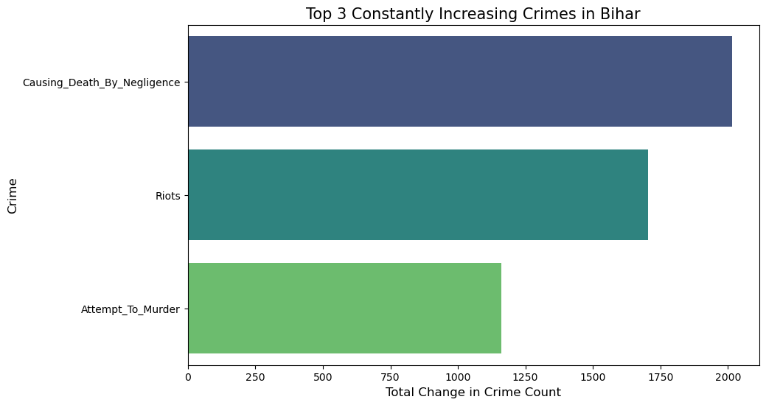
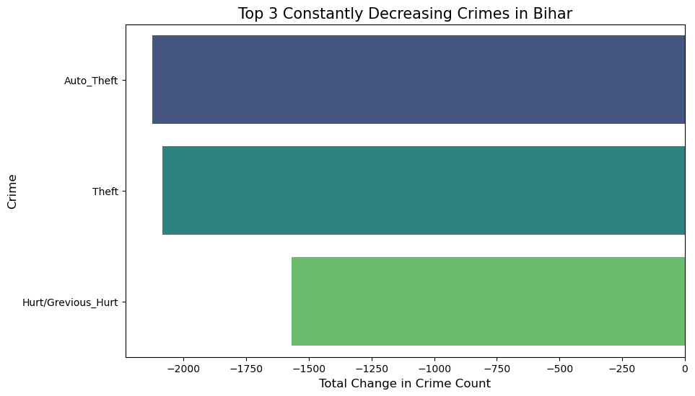
Analysis of Data – Bihar

Slide 9
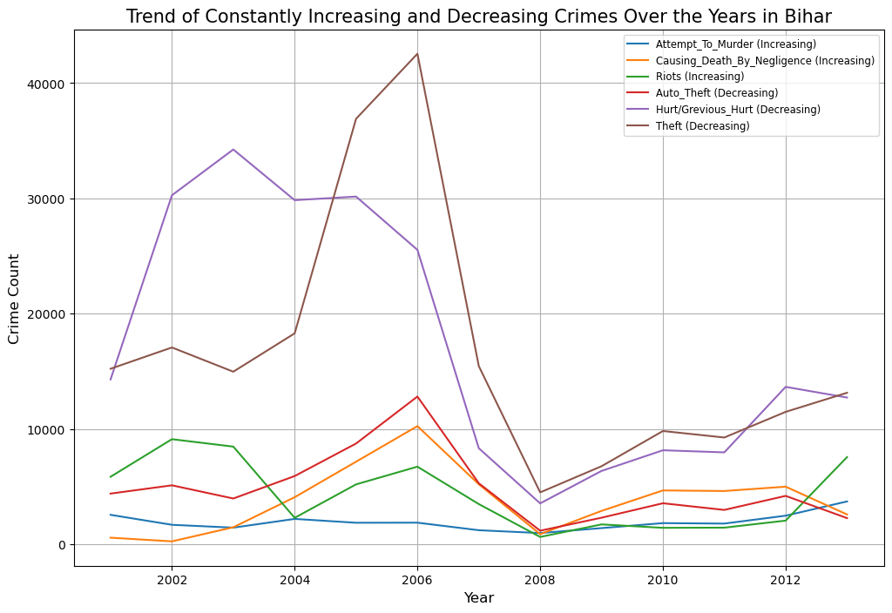

Slide 10
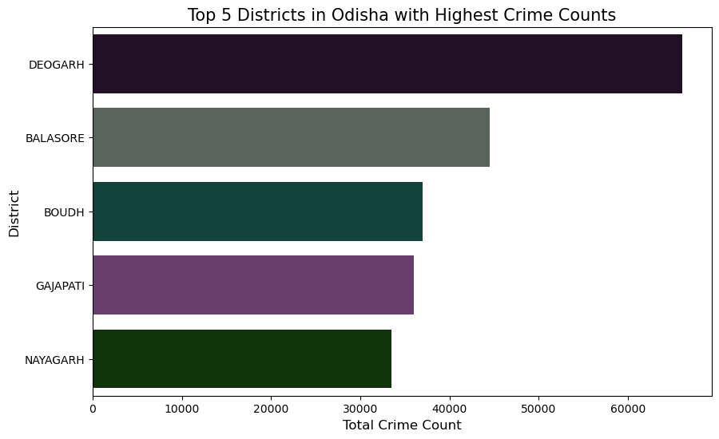
District of Odisha

Slide 11
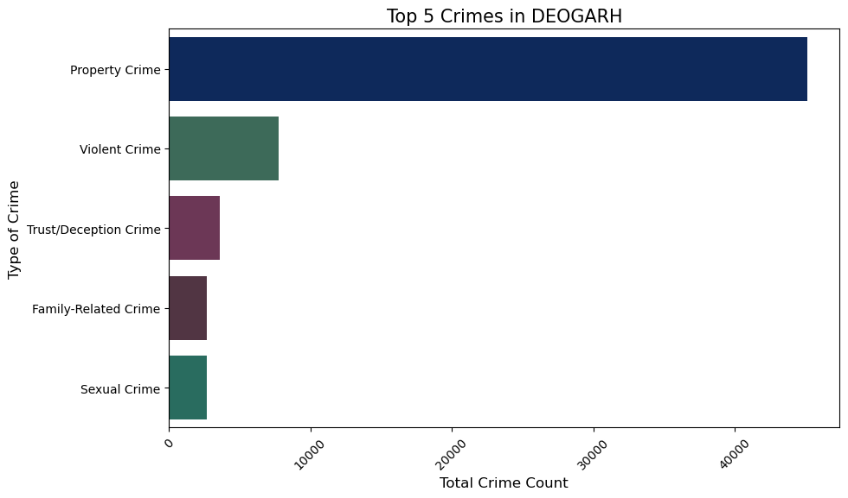
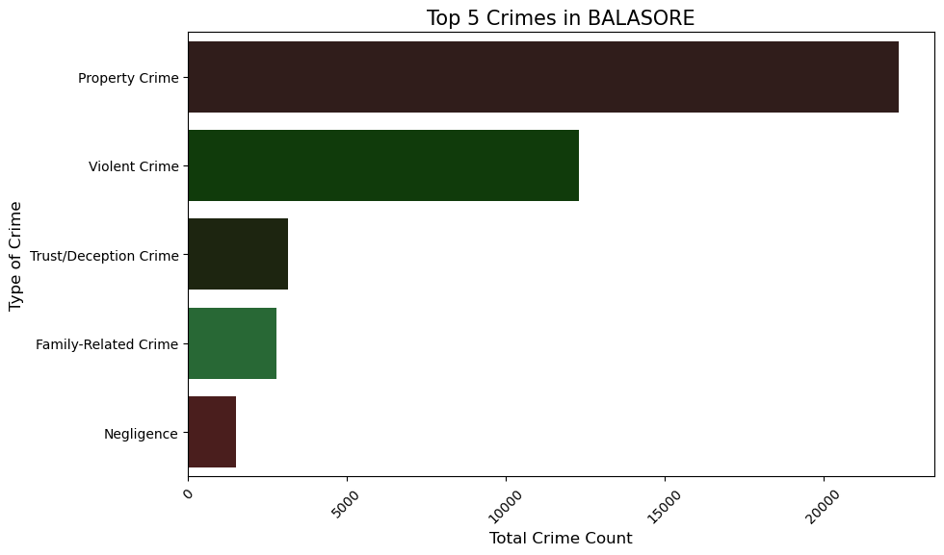
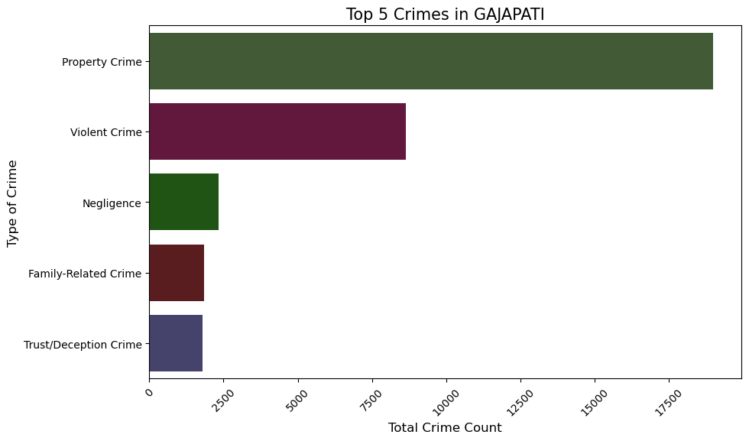
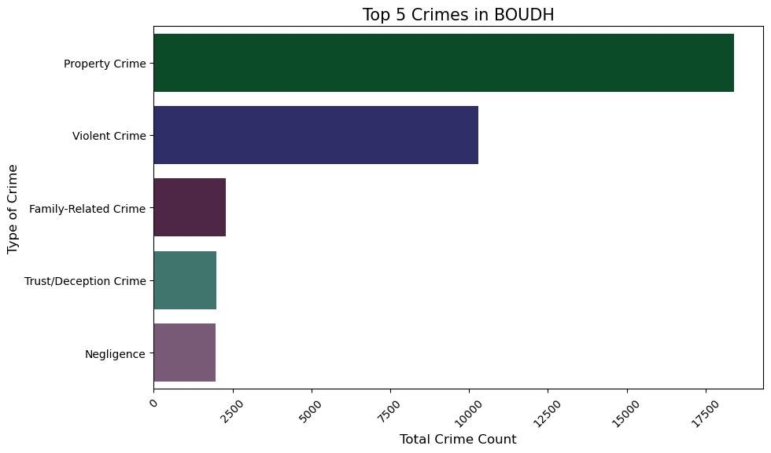
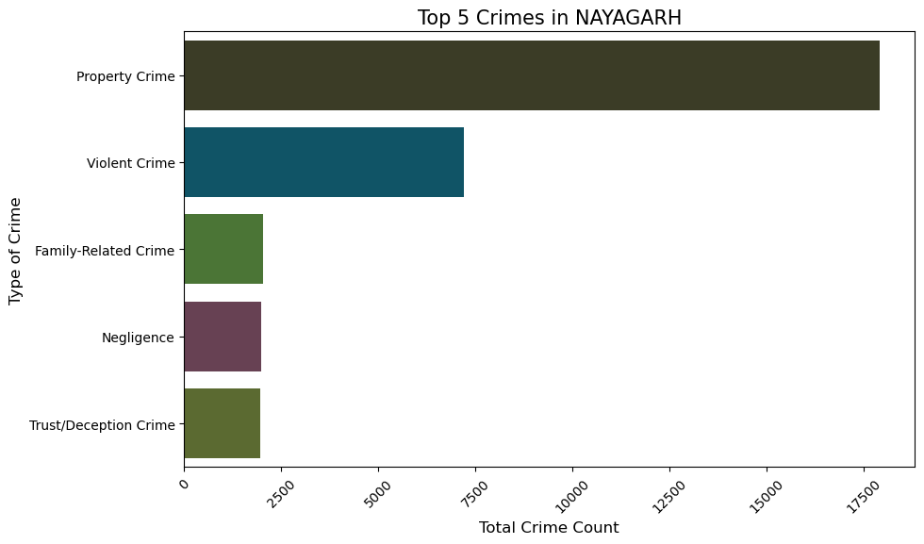
District of Data – Odisha

Slide 12
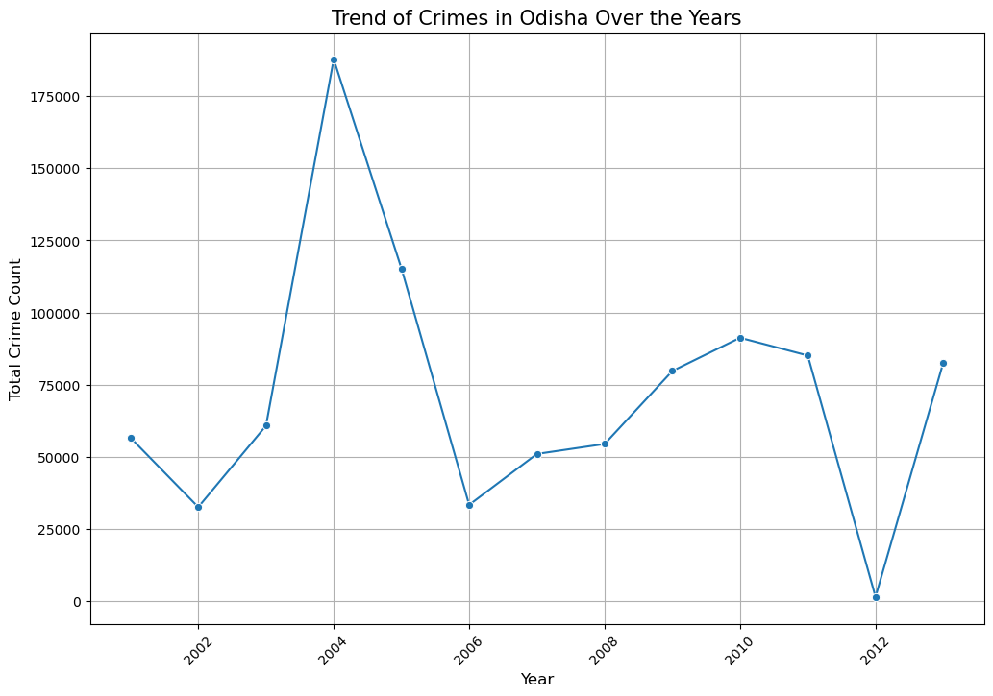
Analysis of Data – Odisha

Slide 13
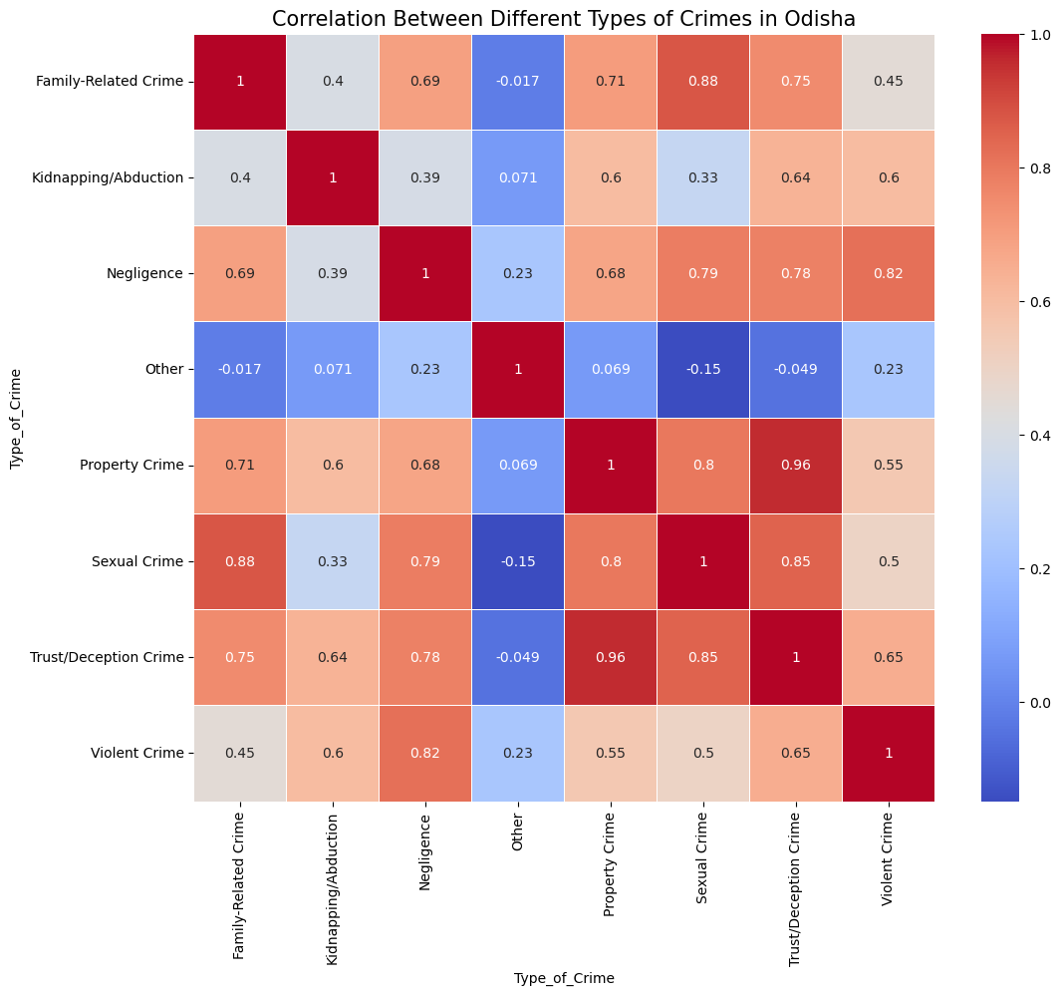
Analysis of Data – Odisha

Slide 14
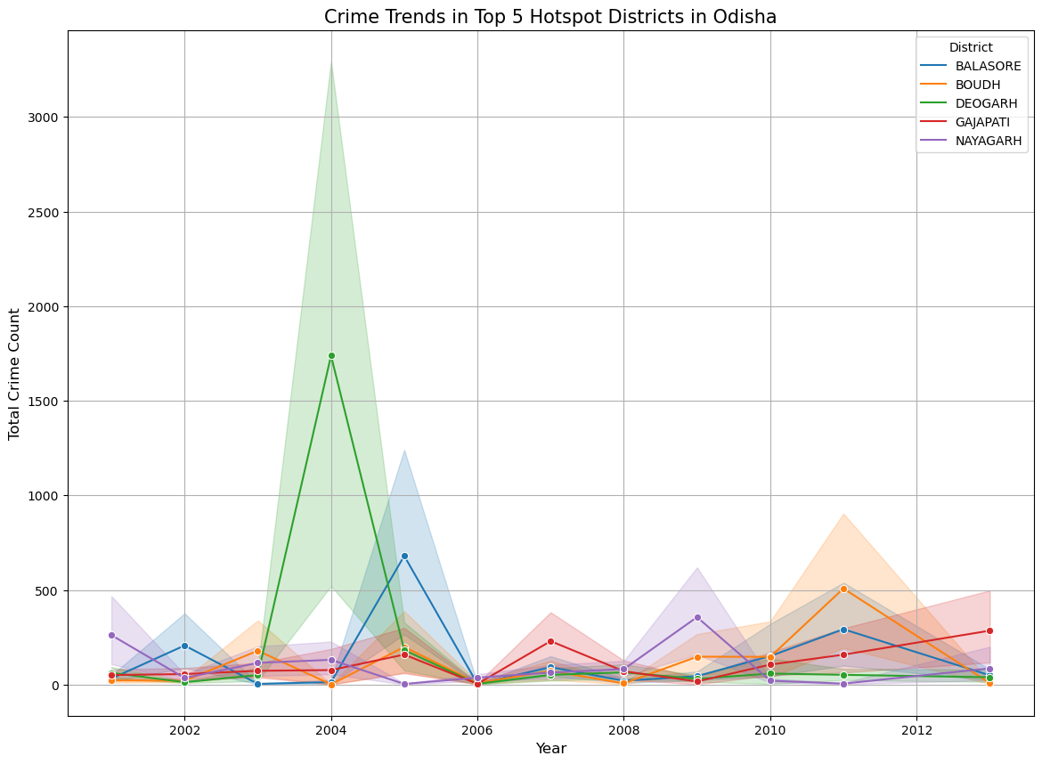
Analysis of Data – Odisha

Slide 15
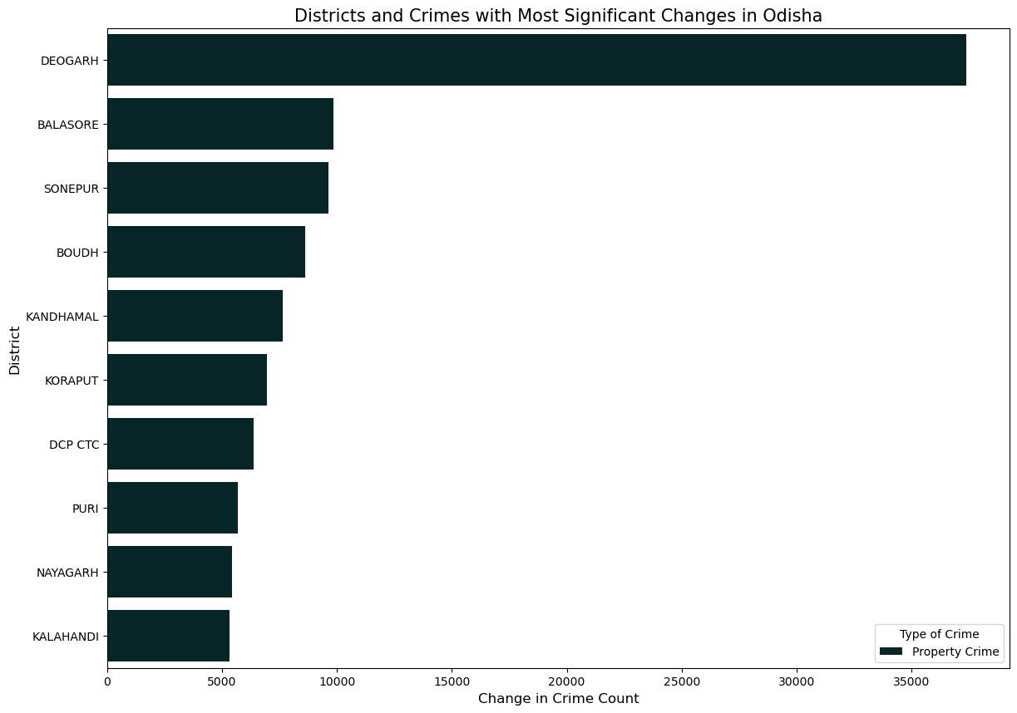
Analysis of Data – Odisha

Slide 16
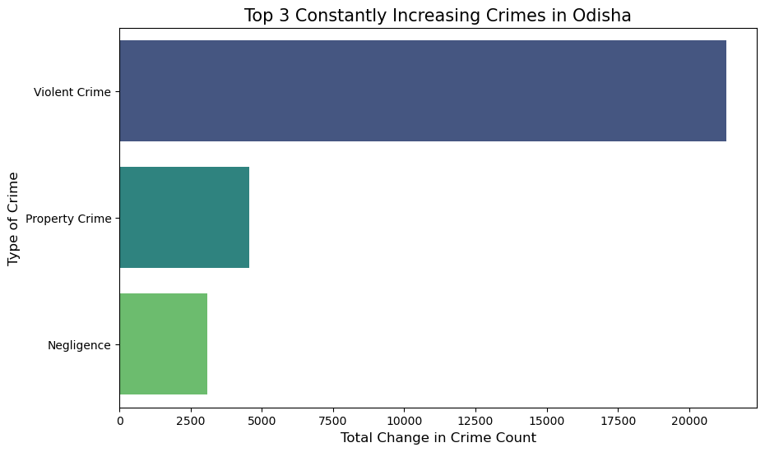
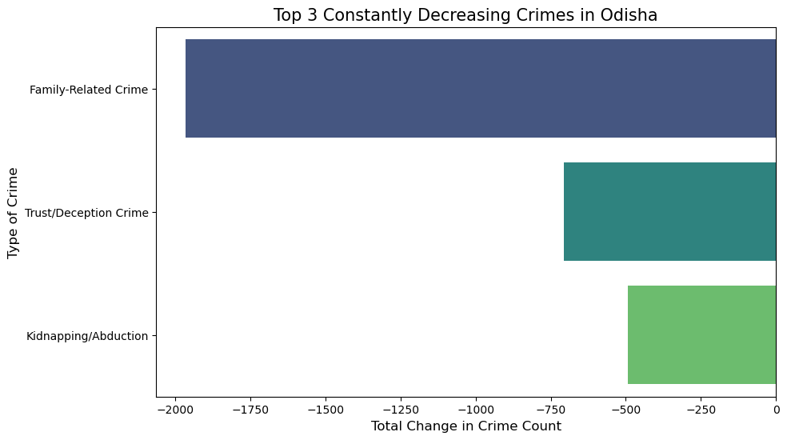
Analysis of Data – Bihar

Slide 17
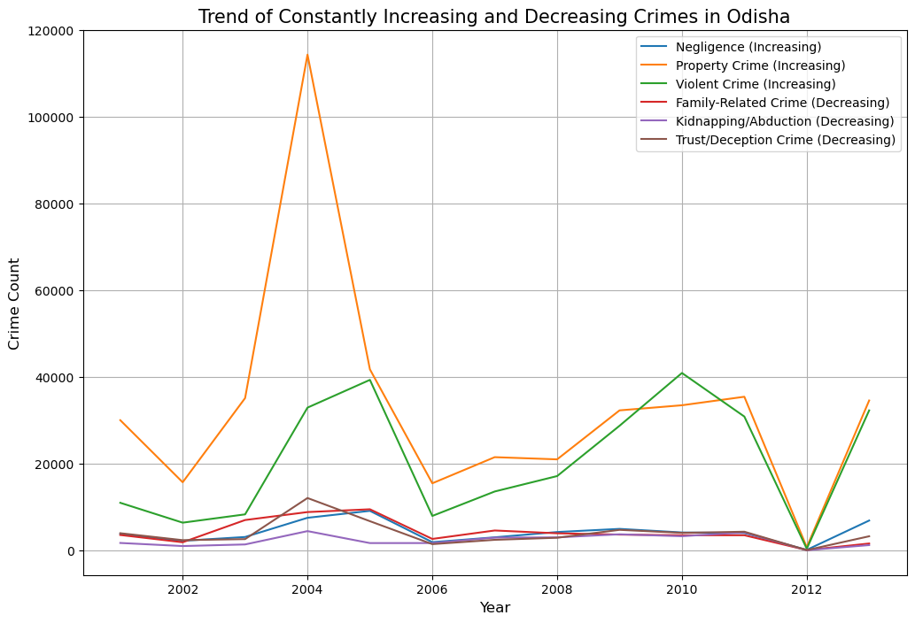
Analysis of Data – Odisha

Slide 18
Jammu and Kashmir
Punjab
North Indian States

Slide 19
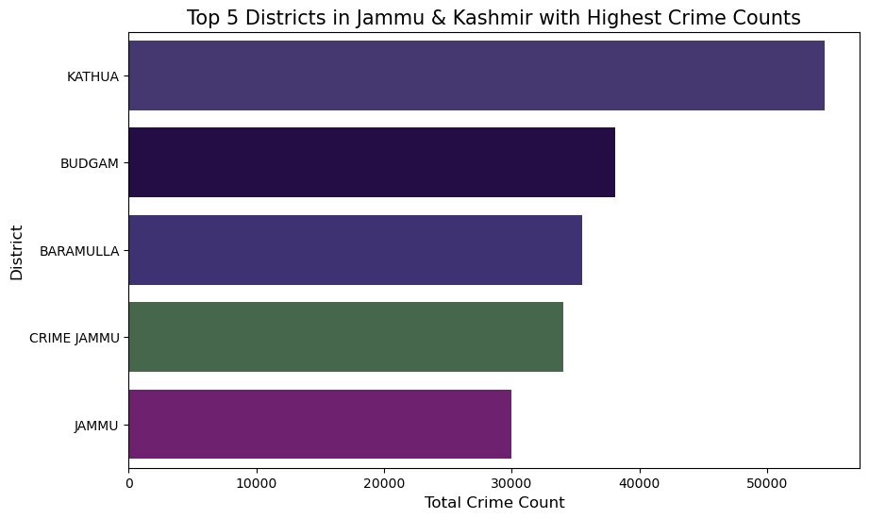
Analysis of Data – Jammu and Kashmir

Slide 20
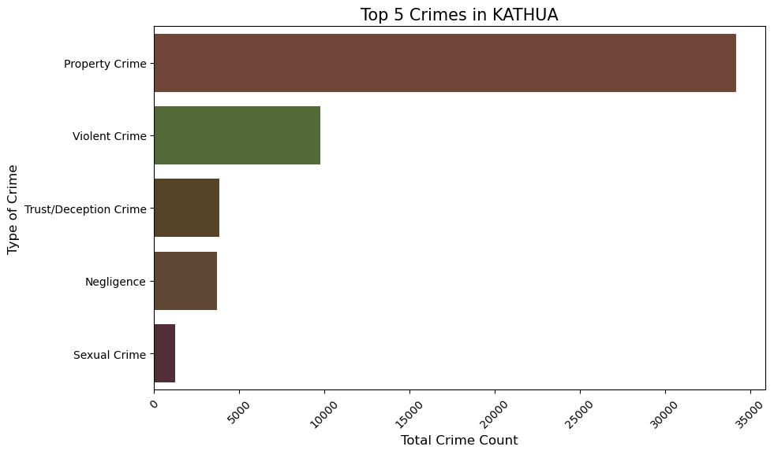
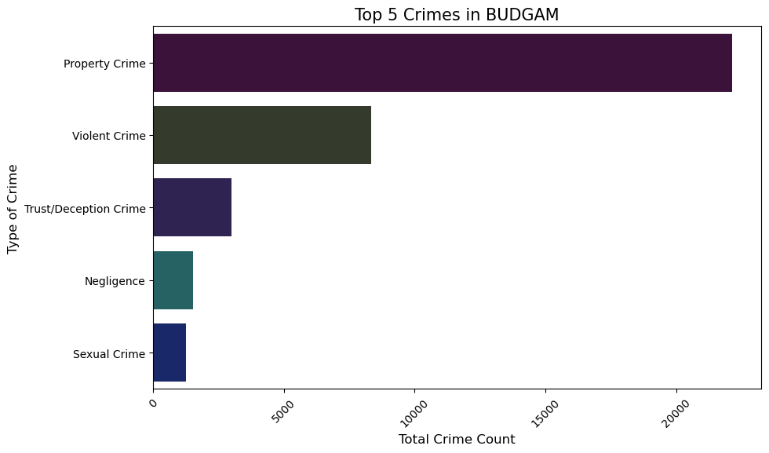
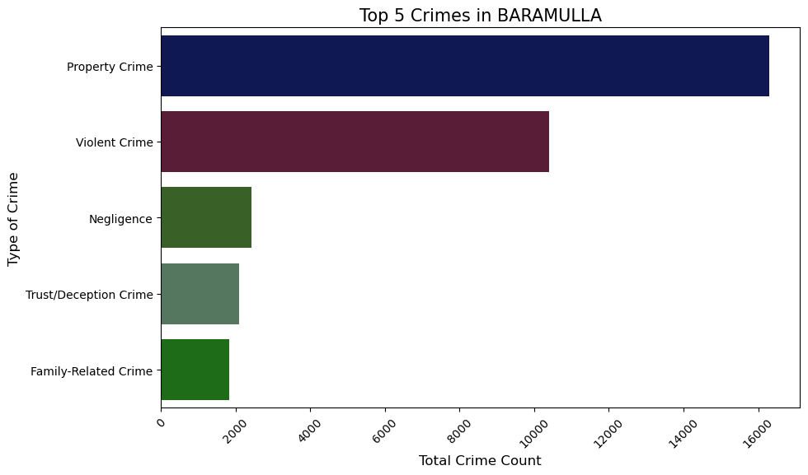
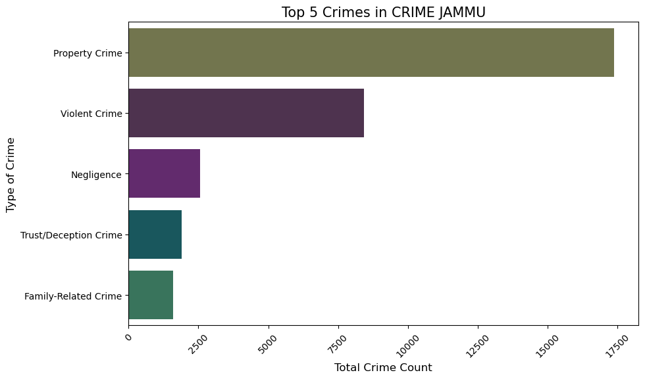
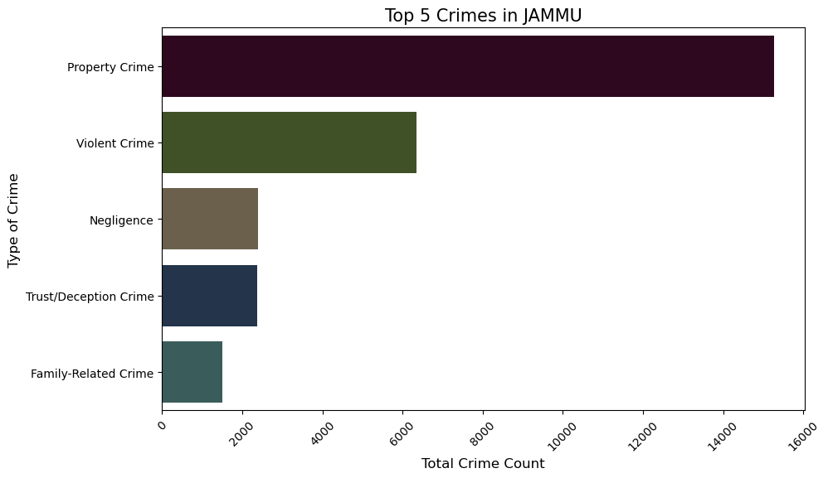
District of Jammu and Kashmir

Slide 21
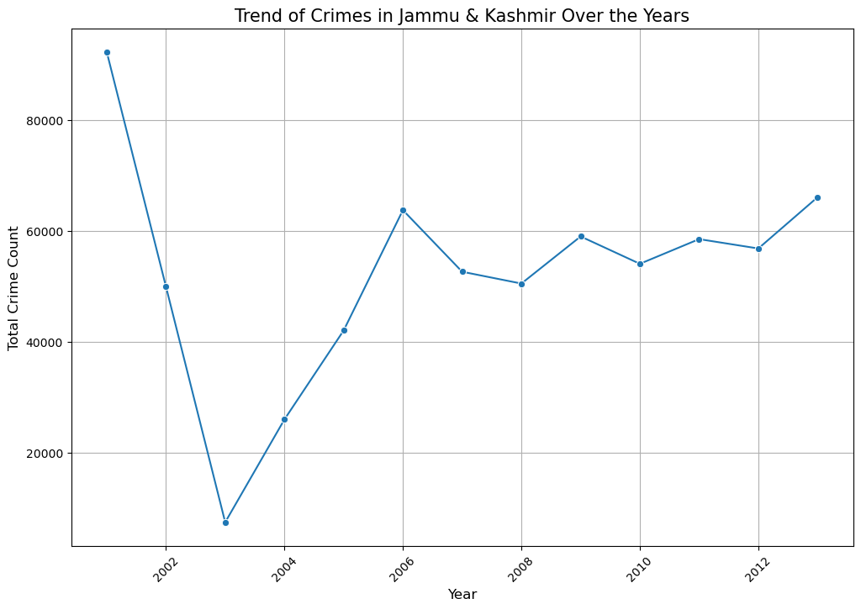
Analysis of Data – Jammu and Kashmir

Slide 22
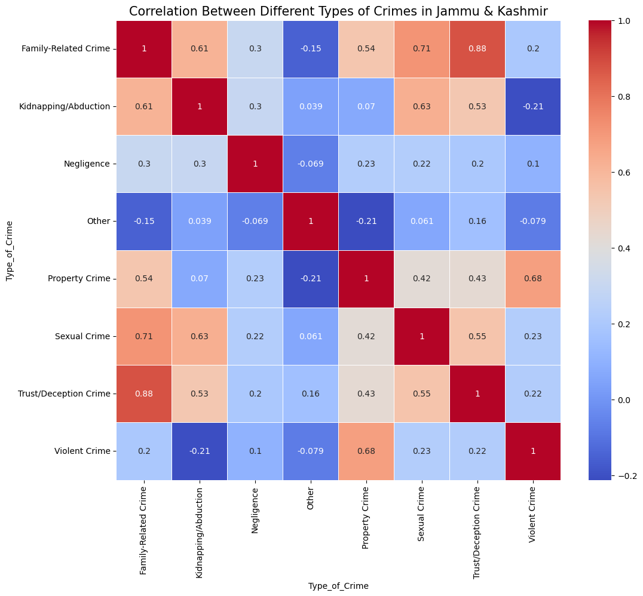
Analysis of Data – Jammu and Kashmir

Slide 23
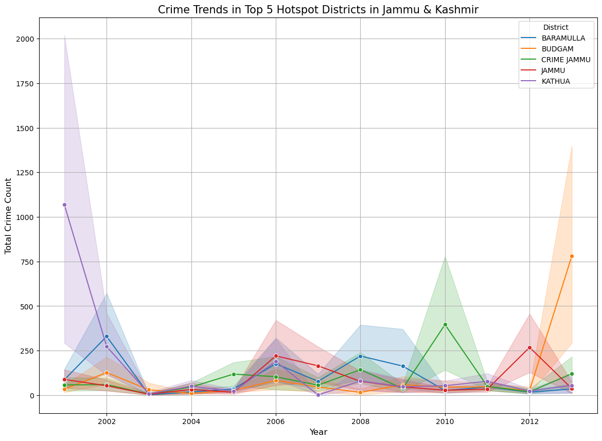
Analysis of Data – Jammu and Kashmir

Slide 24
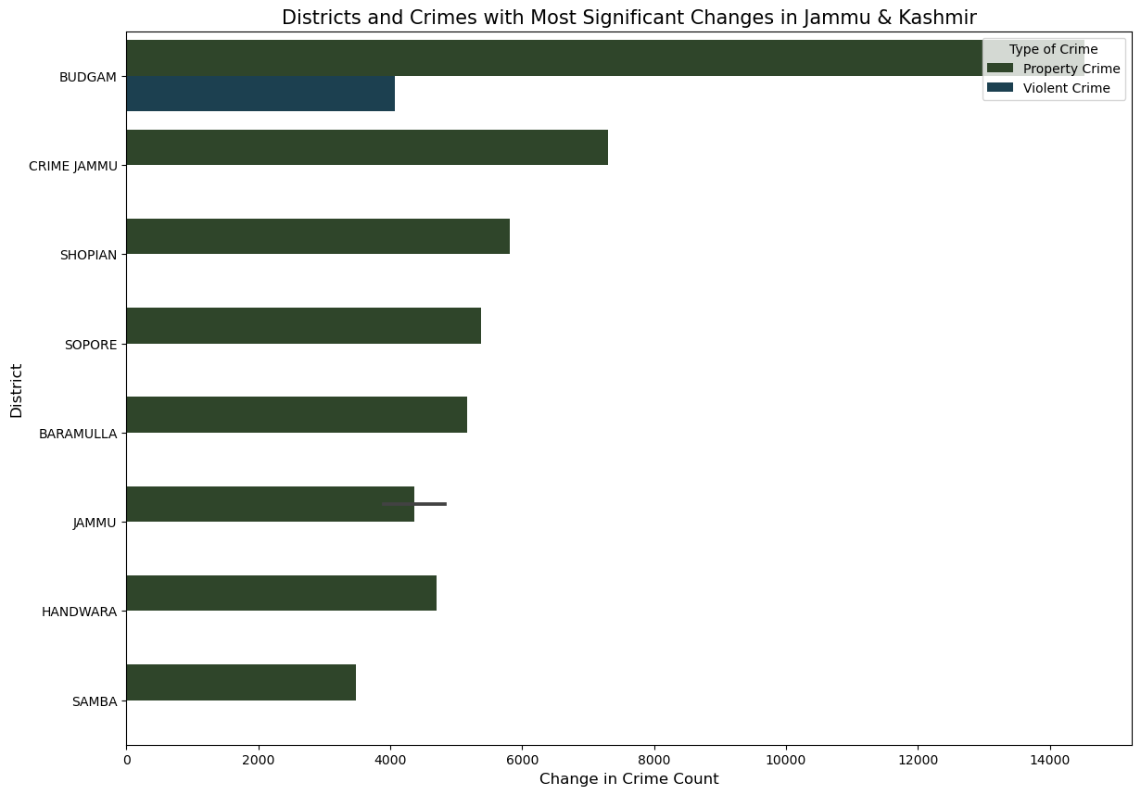
Analysis of Data – Jammu and Kashmir

Slide 25
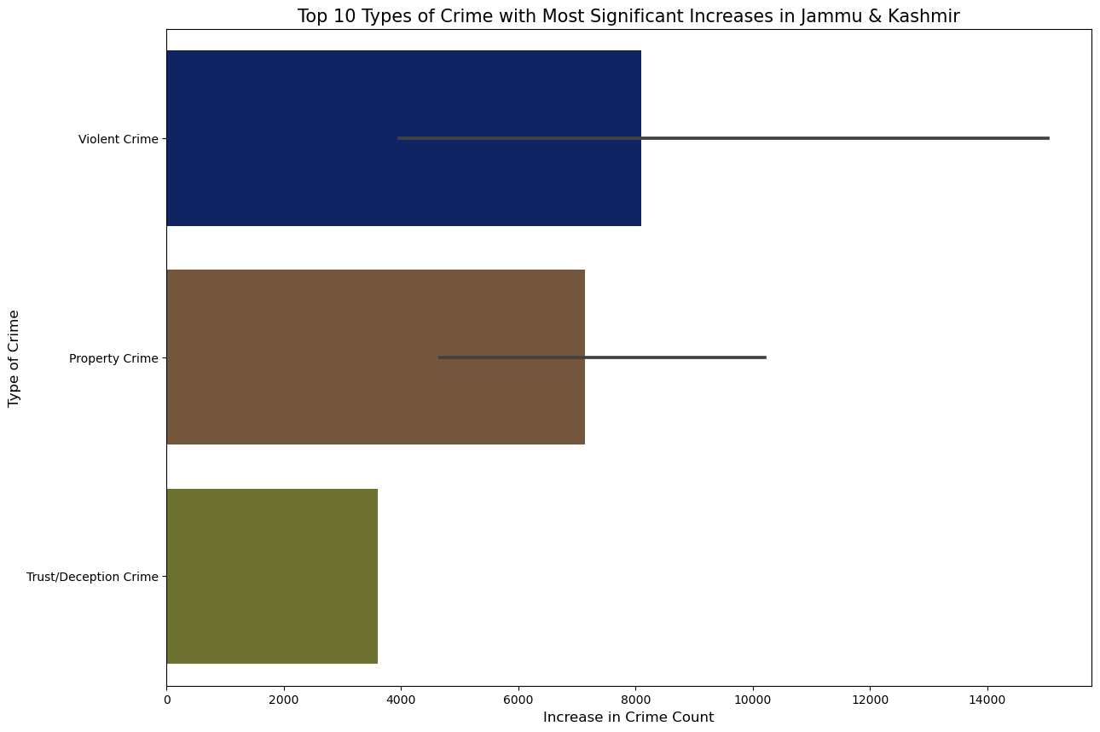
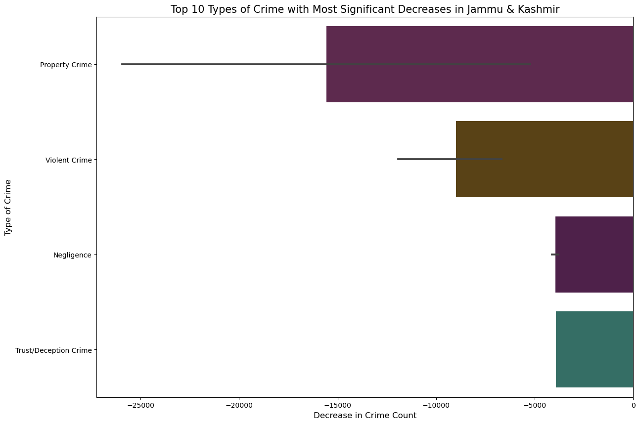
Analysis of Data – Jammu and Kashmir

Slide 26
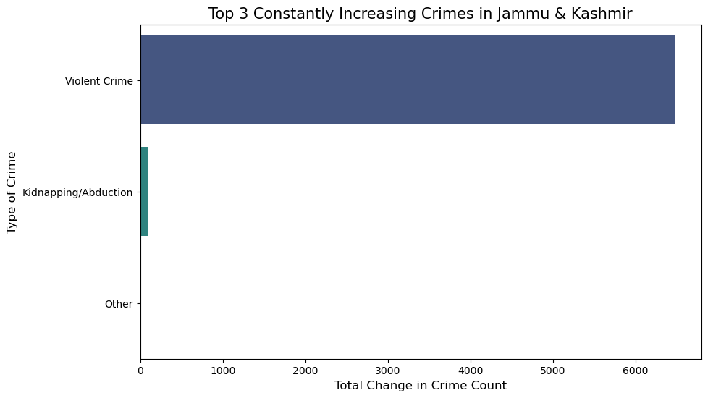
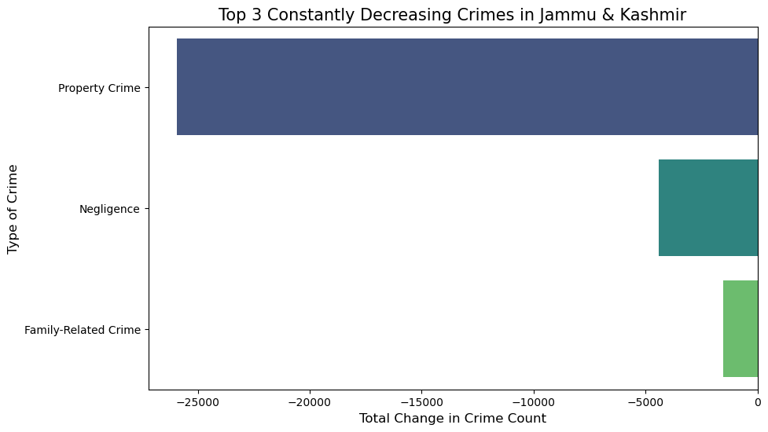
Analysis of Data – Jammu and Kashmir

Slide 27
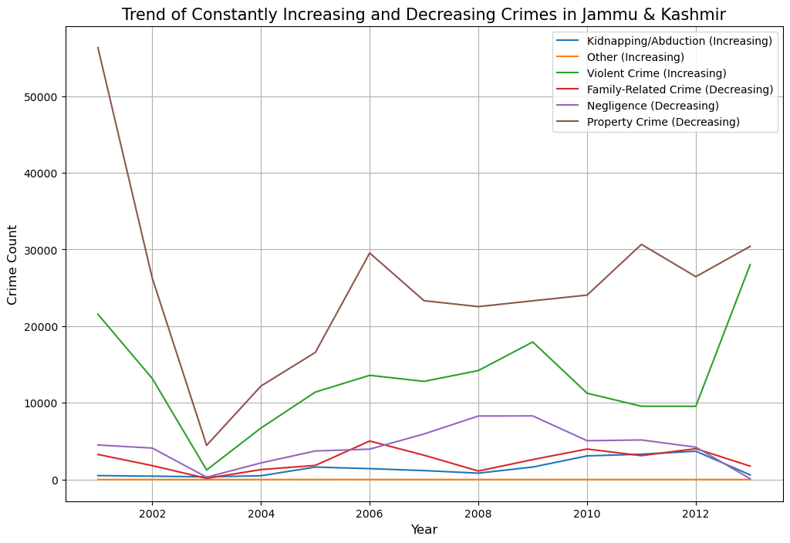
Analysis of Data – Jammu and Kashmir

Slide 28
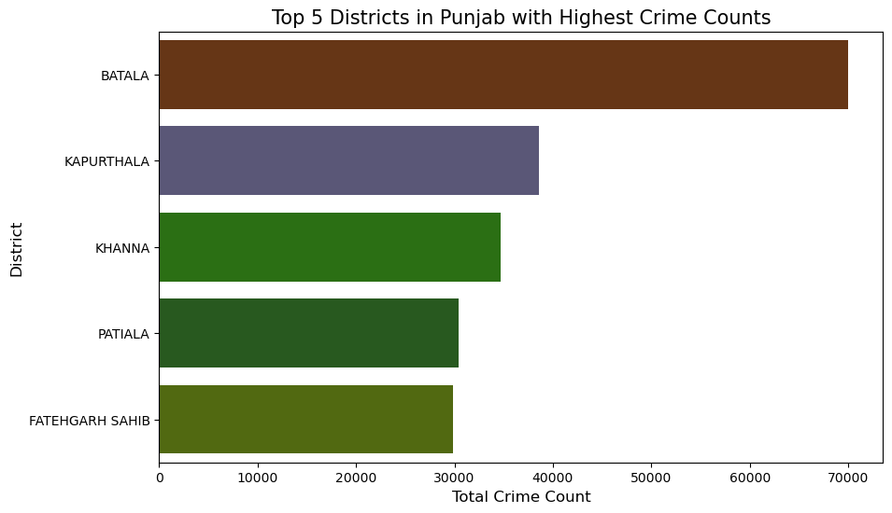
District of Punjab

Slide 29
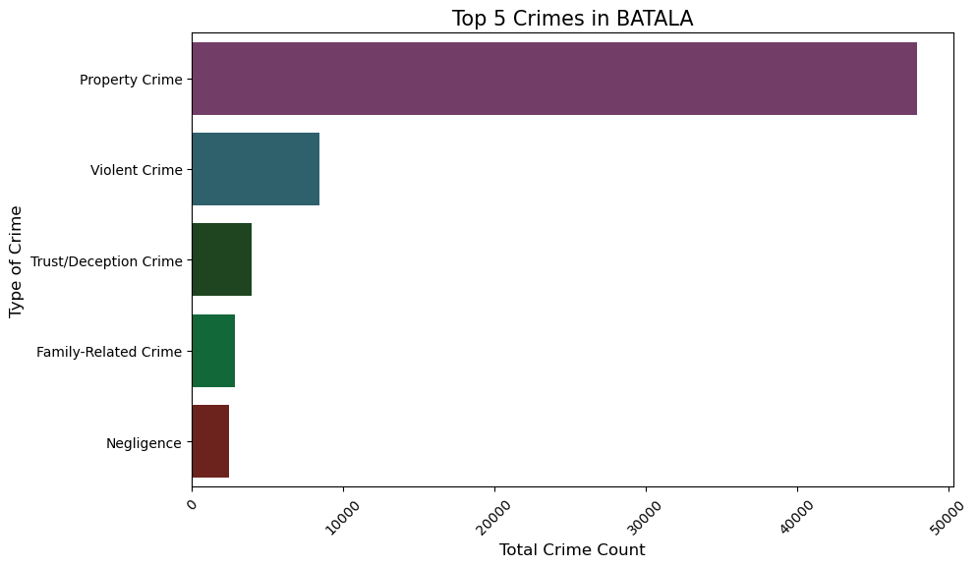
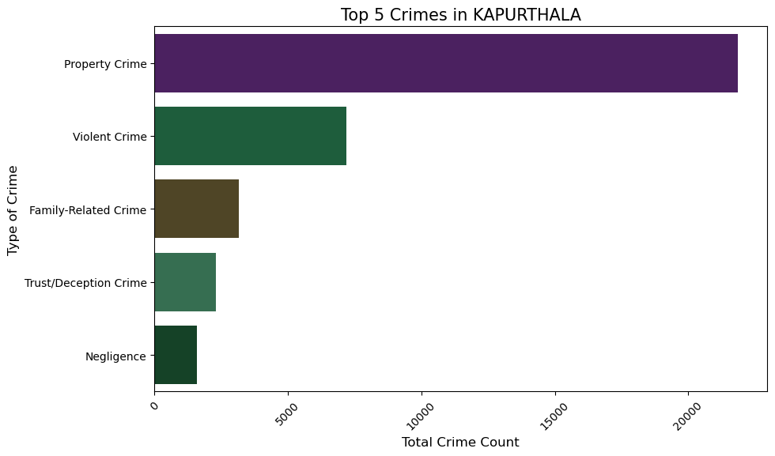
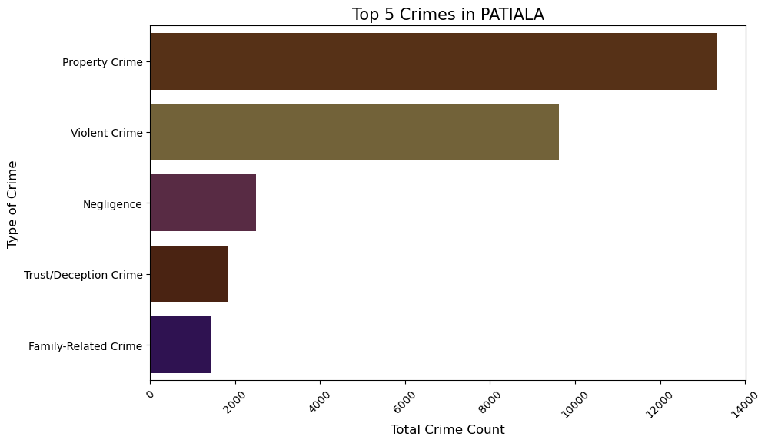
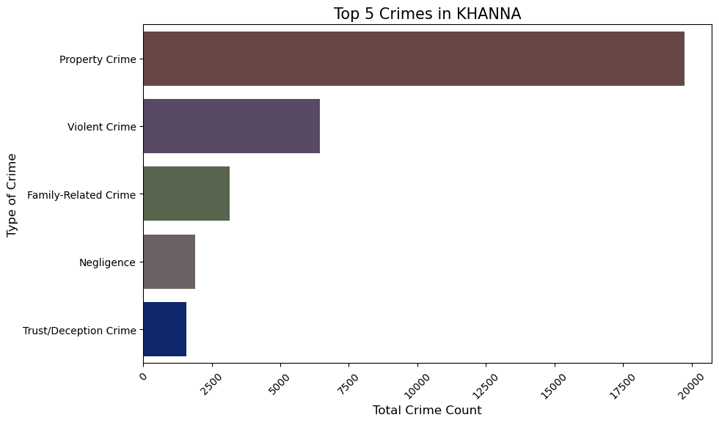
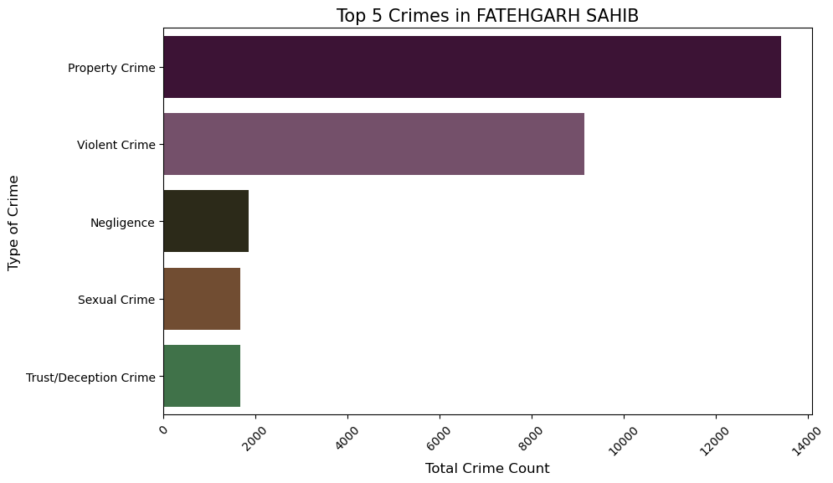
Districts of Punjab

Slide 30
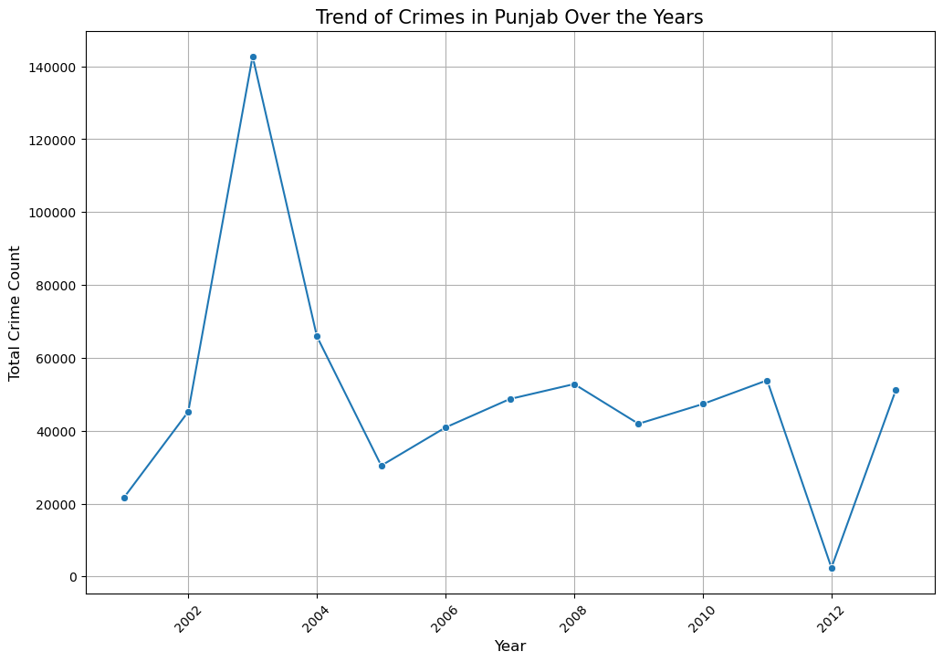
Analysis of Data – Punjab

Slide 31
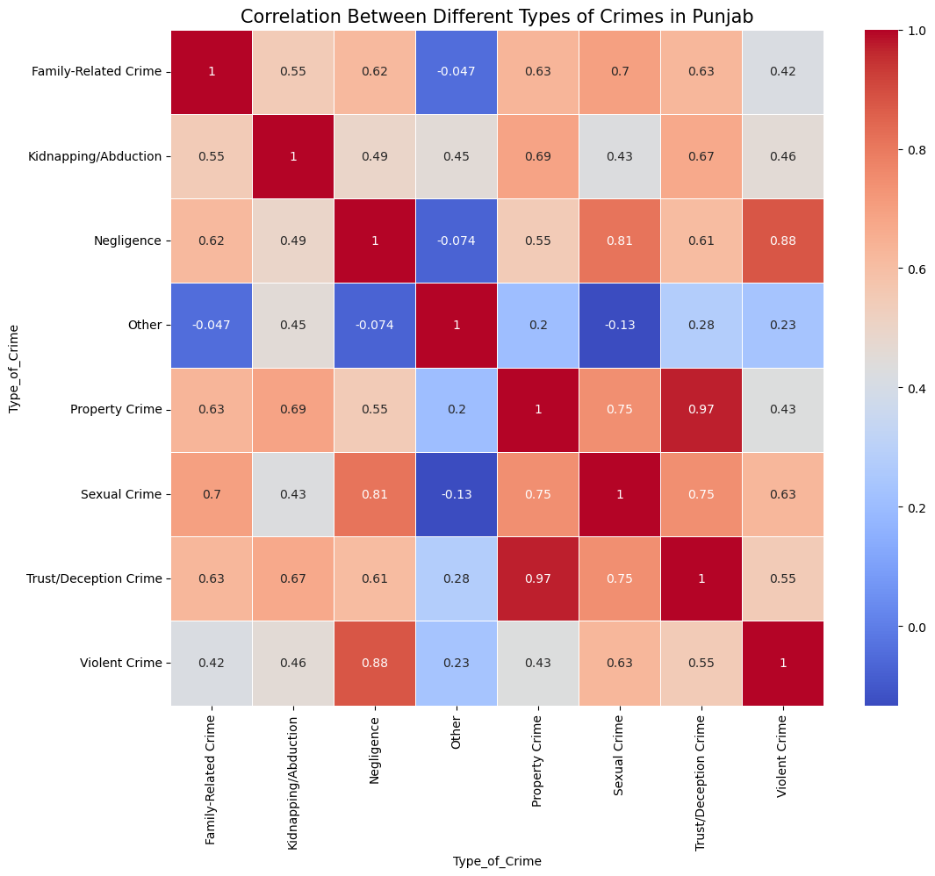
Analysis of Data – Punjab

Slide 32
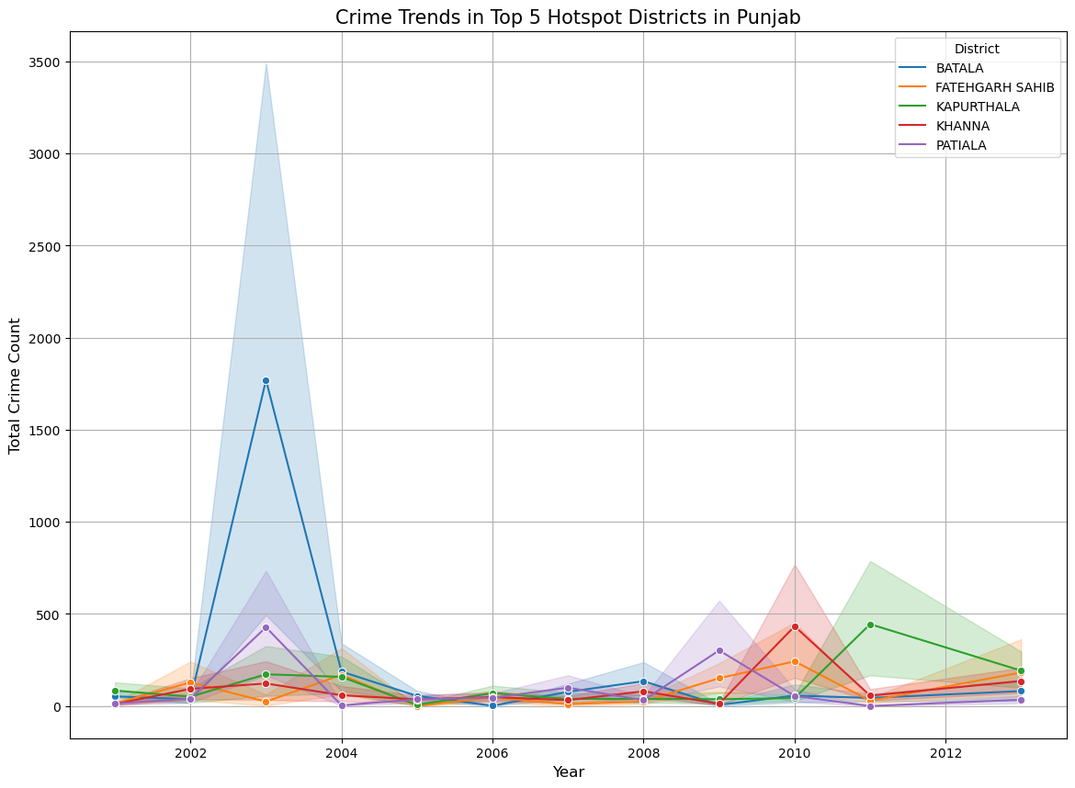
Analysis of Data – Punjab

Slide 33
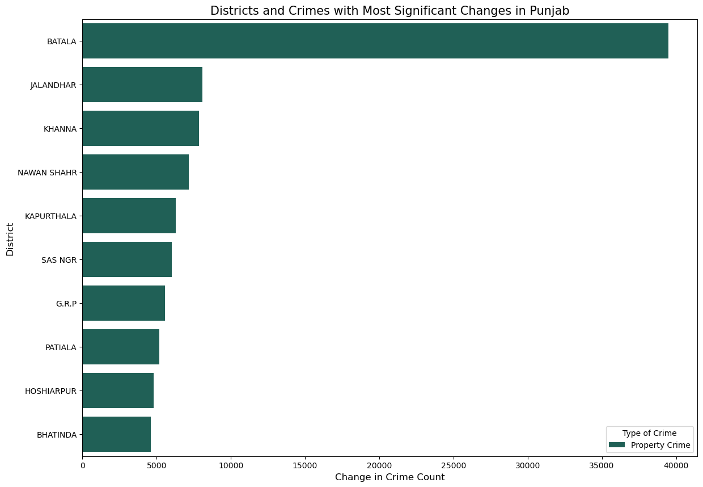
Analysis of Data – Punjab

Slide 34


Analysis of Data – Punjab

Slide 35

Analysis of Data – Punjab

Slide 36

Analysis of Data – Andhra Pradesh

Slide 37





Analysis of Data – Andhra Pradesh

Slide 38

Analysis of Data – Andhra Pradesh

Slide 39

Analysis of Data – Andhra Pradesh

Slide 40

Analysis of Data – Andhra Pradesh

Slide 41

Analysis of Data – Andhra Pradesh

Slide 42


Analysis of Data – Andhra Pradesh

Slide 43

Analysis of Data – Andhra Pradesh

Slide 44

Analysis of Data – Tamil Nadu

Slide 45

Analysis of Data – Tamil Nadu

Slide 46




Analysis of Data – Tamil Nadu

Slide 47

Analysis of Data – Tamil Nadu

Slide 48

Analysis of Data – Tamil Nadu

Slide 49

Analysis of Data – Tamil Nadu

Slide 50

Analysis of Data – Tamil Nadu

Slide 51


Analysis of Data – Tamil Nadu

Slide 52

Analysis of Data Tamil Nadu

Slide 53

Analysis of Data – Madhya Pradesh

Slide 54





Analysis of Data – Madhya Pradesh

Slide 55

Analysis of Data – Madhya Pradesh

Slide 56

Analysis of Data – Madhya Pradesh

Slide 57

Analysis of Data – Madhya Pradesh

Slide 58


Analysis of Data – Punjab

Slide 59

Analysis of Data – Madhya Pradesh

Slide 60
Analysis of Data – Madhya Pradesh

Slide 61
Analysis of Data – Madhya Pradesh

Slide 62
Analysis of Data – Madhya Pradesh

